Slide 1
RELATIVISTIC
DOPPLER EFFECT
PHYS 150 – Special Relativity
Sophia Sosa Fiscella

Slide 2
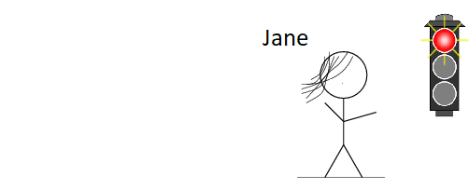
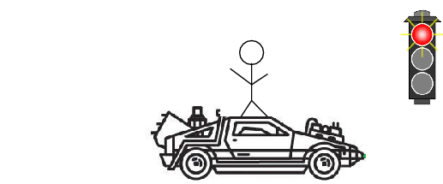
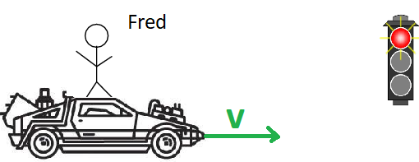
Fred is back (to the future)
v=60 miles/h

Slide 3
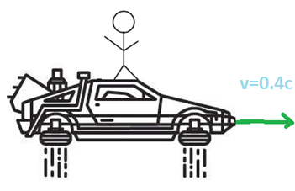
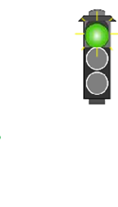
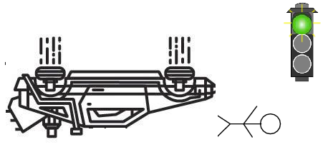
Fred is back (to the future)

Slide 4
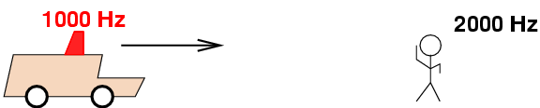

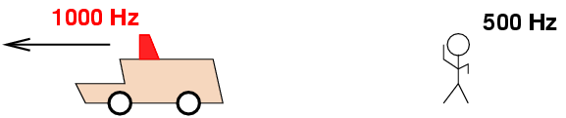


“Ordinary” Doppler Effect
Change in the perceived frequency of a sound due to motion of the source or the observer.
Move towards each other $→$ the observer hears a higher frequency.
Move away each other $→$ the observer hears a lower frequency.

Slide 5
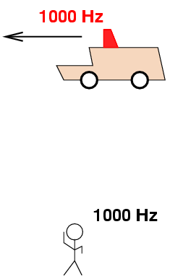

“Ordinary” Doppler Effect
Change in the perceived frequency of a sound due to motion of the source or the observer.
Move transverse to each other $→$ the observer hears the original frequency.

Slide 6

Light is also a wave!
Therefore, it’ll also experience a Doppler effect when the source/observer are moving.
Sound waves require a medium (air) $→$ light waves don’t
Sound waves don’t change frequency when the source moves across the observer’s line of sigh $→$ light waves do change

Slide 7
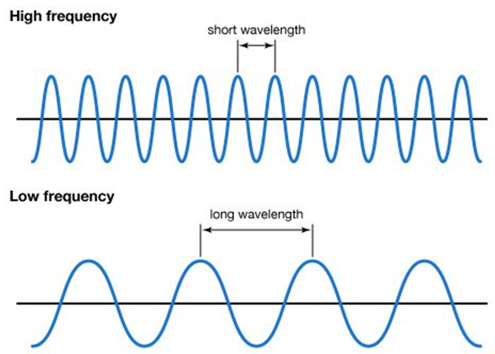




A little bit of math
meter/second
1 Hertz (Hz) = 1/second
(speed of wave)$=$(frequency)(wavelength)
meter
$$v_{wave}=f×λ$$
$$c=f×λ$$
Where:
$$f=\frac{1}{T}$$
Time between two crests of the wave

Slide 8
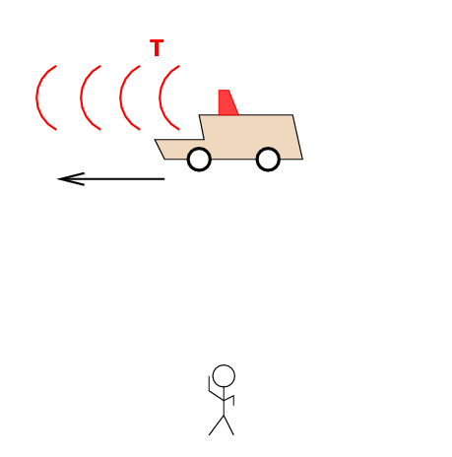





transverse Relativistic Doppler Effect
A car moves across Fred’s line of sight
Car’s reference frame:
$$T=1/f$$
Fred’s reference frame $→$ clocks on the car are ticking slower:
$${\left(Δt\right)}_{car}=\frac{1}{γ}{\left(Δt\right)}_{Fred} , γ=1/\sqrt{1−{v^{2}}/{c^{2}}}$$
$$f_{car}=γf_{Fred}$$
$$T_{car}=\frac{1}{γ}T_{Fred}$$

Slide 9
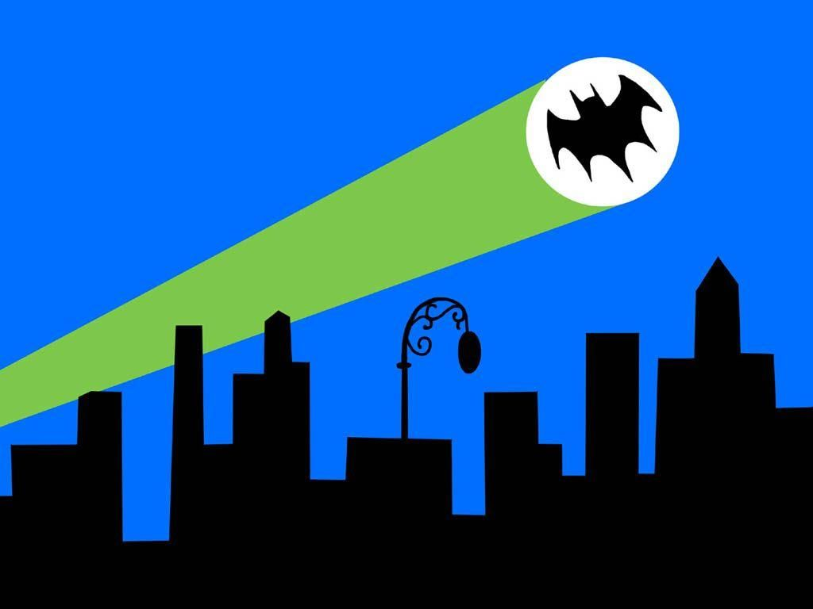

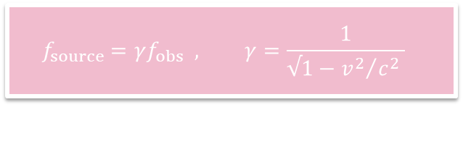
transverse Relativistic Doppler Effect
$$f_{source}=γf_{obs} , γ=\frac{1}{√1−{v^{2}}/{c^{2} }}$$
Captain Gordon points the laser Batsignal, with a frequency of $4×{10}^{14}Hz$, into the sky of Gotham City. Batman observes this while traveling in his batjet perpendicular to Gordon’s line of sigh at $v=0.9c$. What frequency does he measure?
  The same frequency.
  $1.74×{10}^{14}Hz$
  $9.17×{10}^{14}Hz$

Slide 10
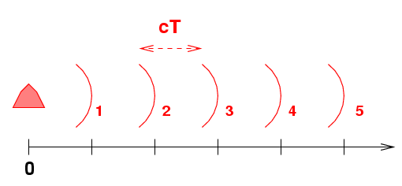


Radial Relativistic Doppler Effect
A lamp emits light with frequency $f$.
Each crest comes out of the lamp a time $T=1/f$ after the previous crest.
The distance between two crests is:
$$distance=\left(speed\right)\left(time\right)=cT$$
“head start”
$$\left\{\begin{aligned}x_{crest 1}=cT+ct \\ x_{crest 2}=2cT+ct \\ x_{crest 3}=3cT+ct\end{aligned}\right.$$

Slide 11
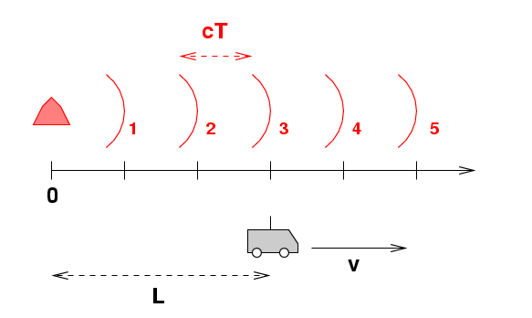


Radial Relativistic Doppler Effect
A car moves to the right at speed$v$.
At $t=0$ the car is at $x=L$.
$$\left\{\begin{aligned}x_{crest 1}=cT+ct \\ x_{crest 2}=2cT+ct \\ x_{crest 3}=3cT+ct\end{aligned}\right.$$
$$x_{car}=L+vt$$

Slide 12


Radial Relativistic Doppler Effect
Event 1: Crest number 1 catches up with the car.
Event 2: Crest number 2 catches up with the car.
In the lamp frame:
$$\left\{\begin{aligned}t_{2}=\frac{L−2cT}{c−v} \\ x_{2}=L+v\frac{L−2cT}{c−v}\end{aligned}\right.$$
$$\left\{\begin{aligned}t_{1}=\frac{L−cT}{c−v} \\ x_{1}=L+v\frac{L−cT}{c−v}\end{aligned}\right.$$

Slide 13
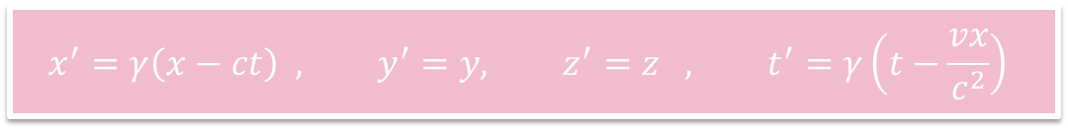


Radial Relativistic Doppler Effect
$$x^{′}=γ\left(x−ct\right) , y^{′}=y, z^{′}=z , t^{′}=γ\left(t−\frac{vx}{c^{2}}\right)$$
In the car frame:
$$t_{2}^{′}=γ\left[\frac{L−2cT}{c−v}−\frac{v}{c^{2}}\left(L+v\frac{L−2cT}{c−v}\right)\right]$$
$$t_{1}^{′}=γ\left[\frac{L−cT}{c−v}−\frac{v}{c^{2}}\left(L+v\frac{L−cT}{c−v}\right)\right]$$

Slide 14


Radial Relativistic Doppler Effect
Interval between two crests, as measured in the car frame:
$$T^{′}=t_{2}^{′}−t_{1}^{′}=…=T\frac{\sqrt{1+β}}{\sqrt{1−β}}$$
$$f^{′}=\frac{1}{T^{′}}=\frac{1}{T}\frac{\sqrt{1−β}}{\sqrt{1+β}}=f\frac{\sqrt{1−β}}{\sqrt{1+β}}$$
the velocity (and β) are POSITIVE if observer and source move AWAY from each other
the velocity (and β) are NEGATIVE if observer and source move TOWARDS each other

Slide 15
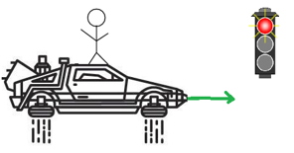
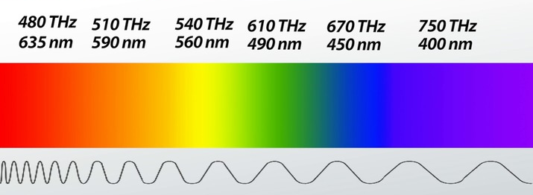
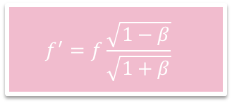


Relativistic Doppler Effect: along line of sight
$$f^{′}=f\frac{\sqrt{1−β}}{\sqrt{1+β}}$$
Fred is driving his DeLorean at a speed of $v=0.4c$towards traffic light that is emitting red light at a frequency of $f=4.3×{10}^{14}Hz$. What frequency does Fred observe?
  The same frequency.
  $6.56×{10}^{14}Hz=656 THz$
  $2.81×{10}^{14}Hz=281 THz$
  What color corresponds to this frequency?
Pst! $1THz={10}^{12}Hz$

Slide 16
