Slide 1
Species Syzygy: Which Animal Has Seen the Most Total Solar Eclipses?
Presented by: Taylor Paul

Slide 2
Factors Considered
Evolution of the Earth – Moon – Sun system
Species time on Earth
Average animal population
Geographic range
Notes:
Specfically look at the horsecrab

Slide 3
Species Awareness
First anecdotal stories
13 / 17 taxa of animals acting different
  8 nighttime routines
  Anxiety in few primates
Including animals capable of distinguishing light and dark and having distant behaviors in each
Notes:
Even if they don’t know, they are still witnessing it

Slide 4
Species Time on Earth
Extinction Rate: 1 – 10 million years timescale
Geographic Range: Time spent in water and not dependent on specific location
Population and Anthropogenic Effects: Average population count over 10 million years and hunting
Notes:
99.99% of species are extinct
Tectonic plates
Hunting = underestimates of animal populations

Slide 5
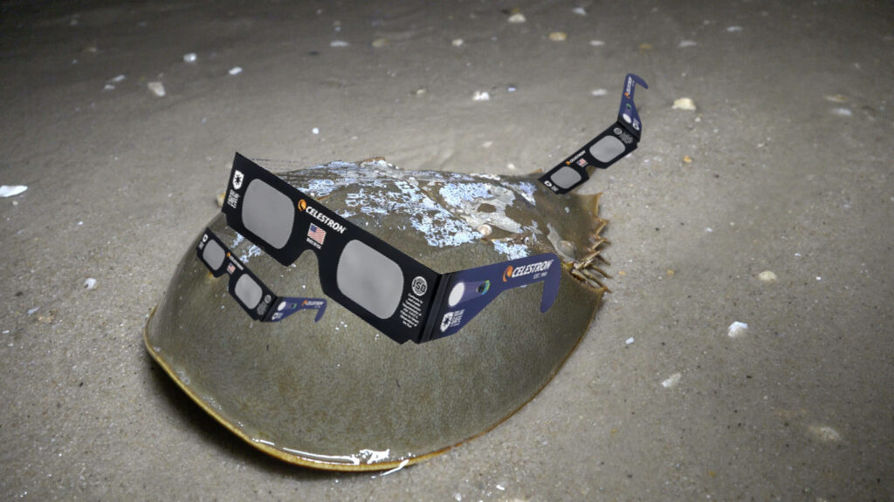
Horseshoe Crab
Notes:
Atlantic horseshoe crab

Slide 6
Horseshoe Crab
Capable of observing
10 eyes
On beach in March and July
Fossil record 480 million years ago
Nearly no evolution in 200 million years
4 species: Limulidae
Notes:
Eyes: 2 sensitive to UV light used to track sun and moon light
Rest of time in ocean
Fig 1 shows 8/10 eyes covered

Slide 7
Evolution of the Sun – Earth – Moon System
Tidal effects of the Moon on the Earth
Averaging over: precession rates, Saros cycles, and eccentricity variations
Use average eccentricities of Earth and Moon orbit
Notes:
Timesteps of 10 million
0.017 and 0.0549, eccentricities affect angular size effecting eclipse, best when Earth: aphelion and moon: perigee (Sun smallest, moon biggest)

Slide 8
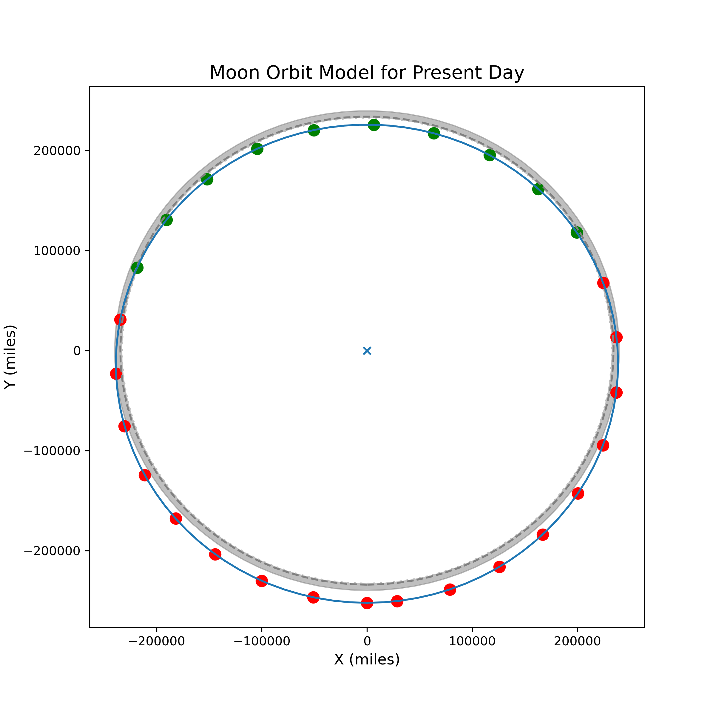

TSE Frequency
Simple model of Moon orbit
Semi – major axis: 239000 miles (roughly 385000 km)
Grey dashed line = max orbit distance for eclipse conditions
Blue solid line = elliptical orbit
Frequency $≈$ 35% of orbit
2 syzygy opportunities per year
1 TSE every 1.4 years
Notes:
Grey dashed line is where we want the moon during eclipse (234400 miles) if earth is at Earth is at average distance from Sun
Grey shell how much radius changes as earth moves from aphelion to perihelion
Green masses are within, red are outside
Blue x is earth
Assume each point of the moon’s orbit is equally likely so number of points within / total number of points = 10/28

Slide 9
World TSE Rate
Location bias?
Meeus (1982): Any point on Earth experiences a TSE every 375 years
Wright (2024): TSE every 366 years (mostly independent of longitude)
Notes:
Meeus: uses stats methods
Wright: NASA catalog of 5000 years of eclipses

Slide 10
AWESOME Time
Astronomical World Eclipse Surface cOverage Metric
Average time it takes the entire surface of Earth to experience a TSE
Normalized over geometric range
Most TSE paths: 100 miles across + stretch 10,000 miles on Earth’s surface = ~ 1 million square miles
Earth surface area: 196 million square miles
AWESOME time: 326 years
Notes:
3000 TSE in 5000 years, TSE covered Earth’s surface ~ 15 times
Divide number of years to cover all of earth one time, you get on average how long it takes to cover the Earth (326 years)

Slide 11
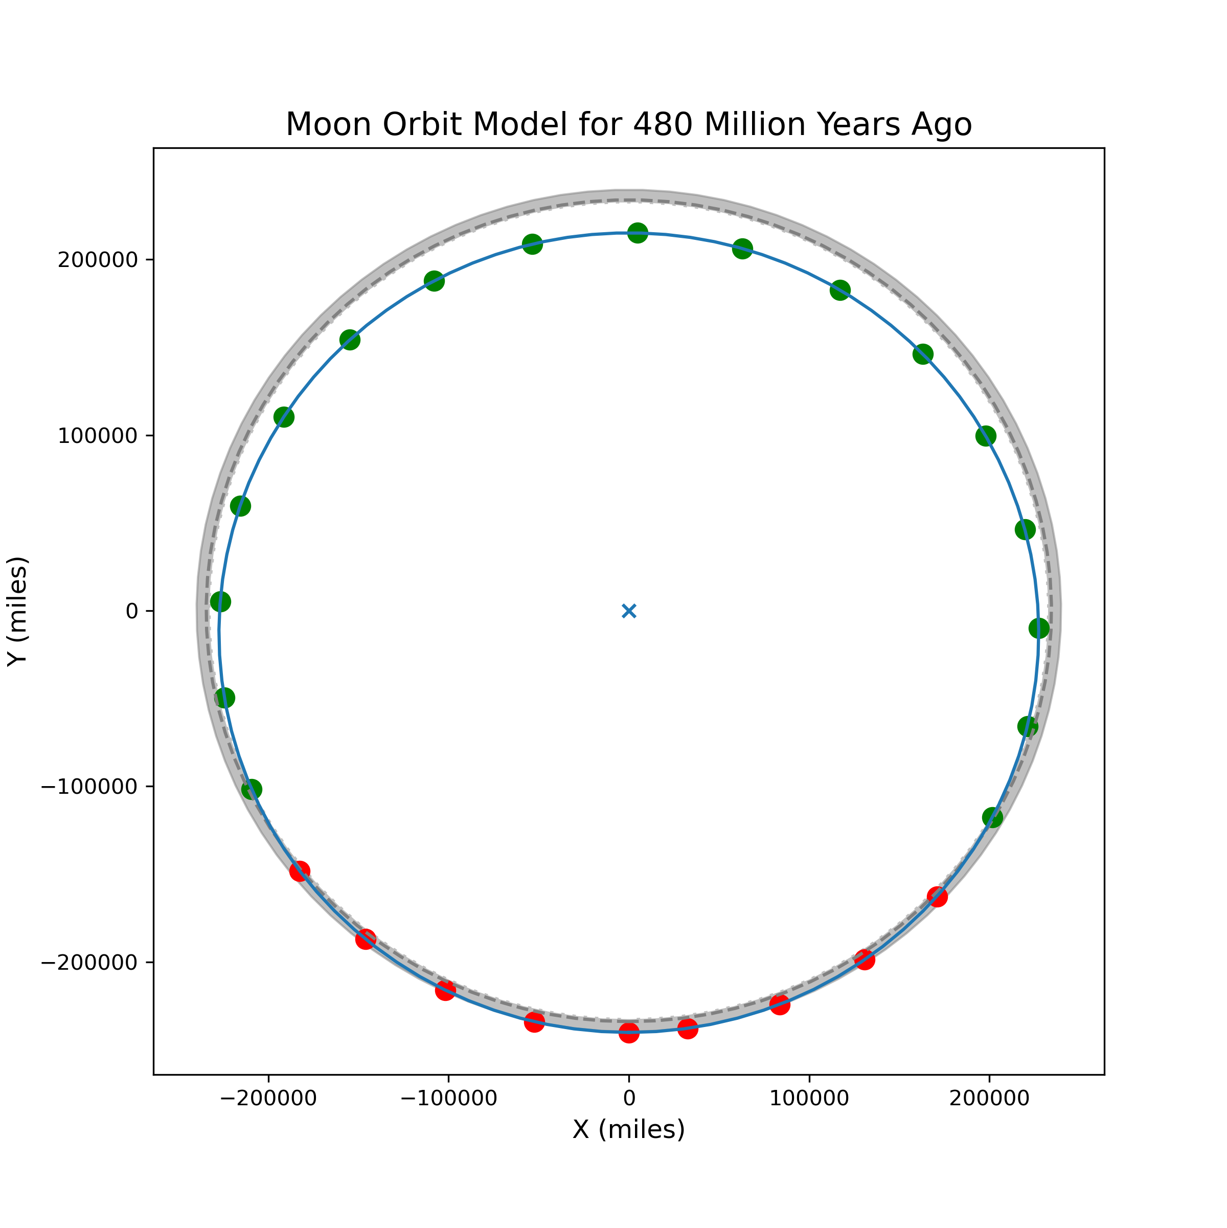
Moon Orbit
Notes:
Closer than todays moon = more often TSE and wider path of totality
Calculated the moons semi – major axis over time
Moon orbit model from when horseshoe crabs
The frequency of TSE per year is higher at ~ 1.2
Made a function for the path of totality
Added a fudge factor (1.723) to account for the curvature of the Earth

Slide 12
TSE per Species
For each time step, make Moon orbit model
Calculate the number of orbit positions within min radius
Calculate time between eclipses & average shadow radius/surface area
Calculate AWESOME time

Slide 13
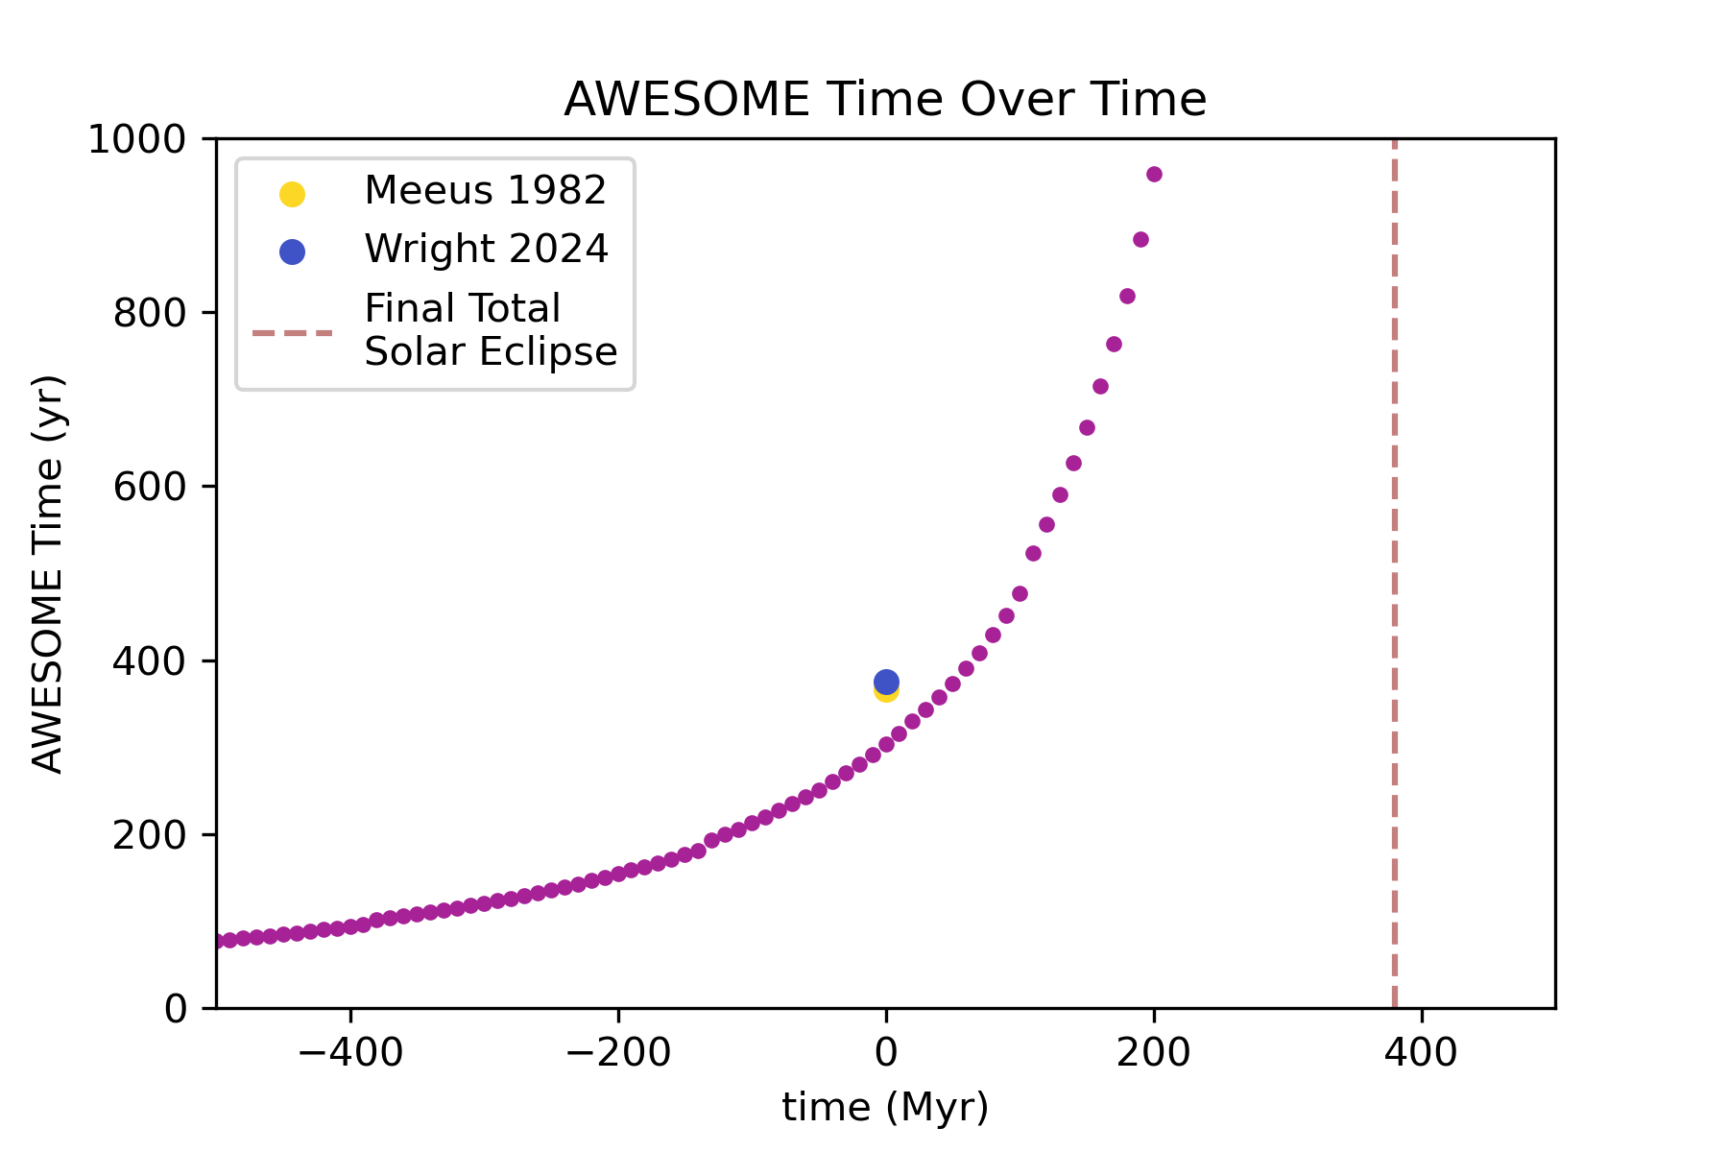
AWESOME Time over Earth Time
Notes:
Awesome time = average time between TSE for a point on the surface of the Earth
Increases exponentially
Shorter in earlier times (500 million years ago, frequency of eclipses was every 7 months)
In 370 million years, eclipses will be 7.5 years on average

Slide 14
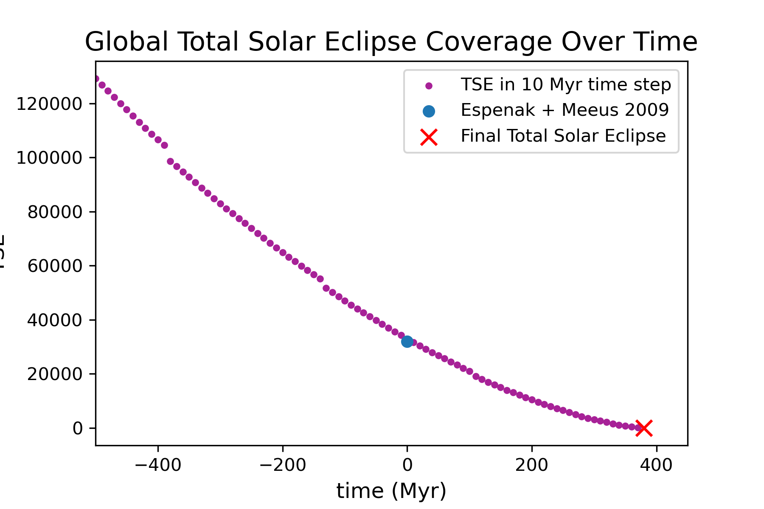
Global Total Solar Eclipses Coverages
Notes:
How many times on average the Earth is covered by TSEs in the 10-million-year time steps & how many TSEs are on a single point on Earth in the 10-million-year period
Number of TSEs divided by AWESOME time
380 million years: last Total solar eclipse

Slide 15
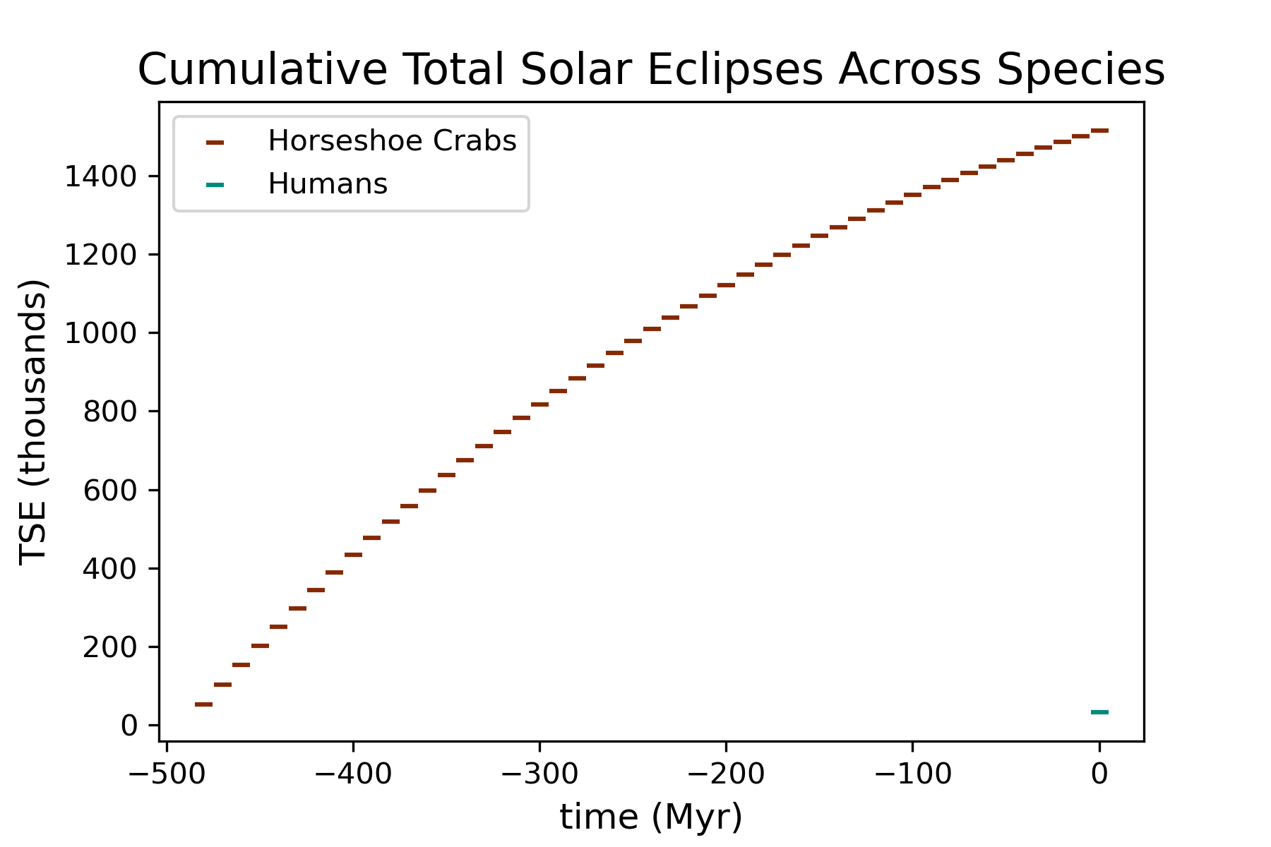

Horseshoe Crabs vs Humans
Notes:
Cumulative TSE for humans and horseshoe crabs
Horseshoe crabs: factored in horseshoe crab only being out of the water from March to July for mating so 5/12 was taken from the results from figure 5
Fun fact the tides caused by the moon affect the breeding season
Horseshoe crabs witnessed 1.5 million eclipses across their species
Using the population over time, roughly 138 trillion TSEs have been experiences for Horsecrabs
Humans: only 32,000 TSE across the species (including last common ancestor of humans and chimpanzees 10 mil years ago)
32 billion TSE experiences based on human populations

Slide 16
Horseshoe Crabs vs Humans
Horseshoe Crabs
  1.5 million eclipses across species
  ~ 138 trillion TSEs experienced
Humans
  32,000 eclipses across the species
  ~ 32 billion TSE experienced
Notes:
Horseshoe crabs: over 3 magnitudes more
Humans could catch up in ~ 400,000 years if people keep gathering for them
Probably not feasible
Horseshoe population is suffering: harvesting blood for pharmaceuticals

Slide 17
Summary
AWESOME time = average time between TSEs for a given point on Earth & average time for whole Earth to experience one TSE
TSEs have changed over time
Last TSE = 380 million years from now
Method to calculate TSE per species
Horseshoe crabs across the species had 138 trillion experiences and humans only 38 billion
Humans will beat horseshoe crabs in less than 10 million years

Slide 18


