Slide 1
Detection of Rotational Variability in Floofy Objects at Optical Wavelengths
Presented by Diana Ryder

Slide 2
Background
The viewing geometry of an observation determines the amount of reflected light detected from an object
The measurement of optical light curves has been particularly well used in the study of small solar system bodies
Determining the properties of exoplanets is challenging
Hot Jupiters: short circular orbits
Longer orbits?
Notes:
The viewing geometry of an observation determines the amount of reflected light detected from an object
The measurement of optical light curves has been particularly well used in the study of small solar system bodies
Brightness -> shape + spin period = density, assuming uniform brightness and composition
Issue: planets aren’t typically uniform (Jupiter’s bands, Earth and Mars’ ice caps)
Determining the properties of exoplanets is challenging, since we don’t always know the observing angle
Solar system objects = easy -> direct missions = different viewing geometries = light curves = object shape and period -> infer other properties
Hot jupiters frequently have circular orbits = tidally locked to host star (synchronous rotation timescale < orbit timescales) = negligible axial obliquity = assume the observation latitude based on the planet’s orbital inclination
Longer orbit = possibly not tidally locked = cannot assume latitude of the planet based on the viewing geometry of the plane of the planet’s orbit = extremely difficult to constrain rotation rate = degeneracies when determining the observed planet side (cannot determine the observed planet side)

Slide 3
Background
Difficulties: noise, background source contamination and misclassification of observed objects
Solution: use color and a variety of filter combinations
Low or high density?
“Floofy” Objects or UFOs
Potentially rotationally variable objects with tentative variable reflectivity as a function of viewing angle
Authors confident these objects will provide an unending amount of joy as astronomers work to understand their unique peculiarities
Notes:
Noise: allow us study of the nuances in the light curves
background source contamination and misclassification of observed objects
Solution: use color (not just brightness), and a variety of filter combinations
low vs. high density = differences between eclipses and transits in specific colors
Gas giants = blue optical slope (Rayleigh scattering), red optical and near-infrared spectral features are due to a variety of gas species
High altitude condensates/photochemical hazes result in degeneracies between the density regimes
“Floofy objects” or UFOs (Understudied Floofy Objects)
Potentially rotationally variable objects with tentative variable reflectivity as a function of viewing angle, similar to the variance seen in Solar System planets and exoplanets
Remains to be seen where these object lie in the classification of planets, brown dwarfs, asteroids, stars, and other rotationally variable objects
Authors confident these objects will provide an unending amount of joy as astronomers work to understand their unique peculiarities

Slide 4
Data Collection
Solicited catstronomers through social media
Image criteria: floofy object rolling around, interest in floofy objects with different colored belly and non-belly regions, wanted images to be used for research
Additional information: well-lit observations (large SNR, minimal contamination), observations from different angles, transiting and eclipsing objects
Overwhelming community response

Slide 5
Methods
Frame color-correction to account for differing seeing conditions and remove nearby colorful companions
Prior research: frame center has relatively constant flat field and gain components
Each object is highly resolved and not rotationally symmetric
Remaining colorful backgrounds are removed manually
Visual classifications
White balancing: account for variations in lighting across images of the same object
Normalize image in each channel
Determine average brightness in each channel
Notes:
Frame color-correction to account for differing seeing conditions and remove nearby colorful companions
Prior research: frame center has relatively constant flat field and gain components (no flat field correction to the data)
Each object is highly resolved and not rotationally symmetric (no comparison of aperture sizes and use of default background removed frames)
Remaining colorful backgrounds are removed manually
Visual categorization and positioning
White balancing: account for variations in lighting across images of the same object
Normalize image in each channel (assume that the whitest patch is set at the 98th percentile of the image intensity values)
Determine the average brightness in each channel
the choice of data reduction method can have a large impact on the resulting rotation curves
A uniform application of data reduction method is key to determining trends in an underlying population

Slide 6
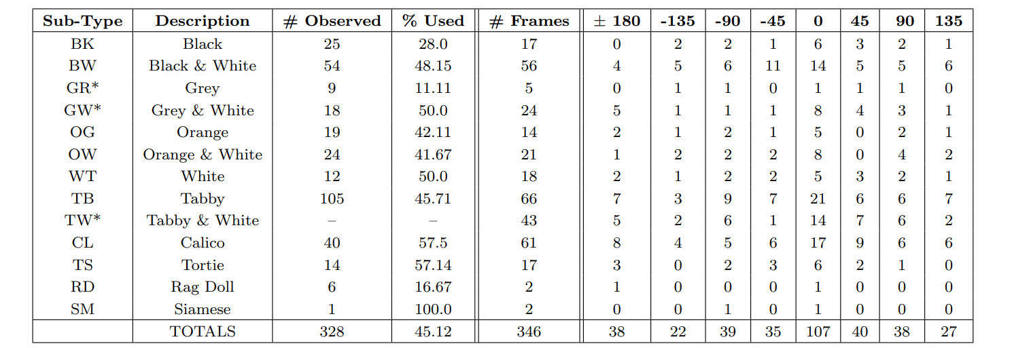
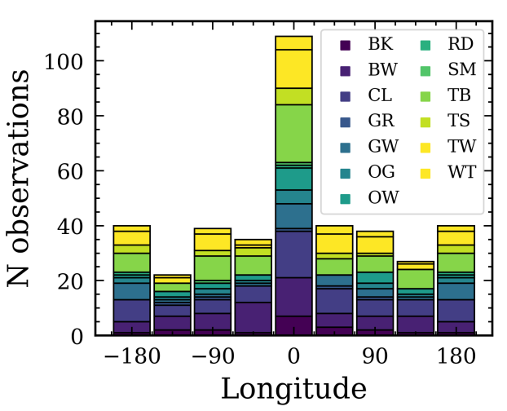
Data Analysis
Visual sub-type classifications attempt to follow previously identified color trends
Different sub-types were added as necessary throughout the classification process
Notes:
Asterisked sub-types: later additions
TW from TB, GW from BW, GR from BK
Unused GR, GW, and TW may be classified as BK, BW, and TB respectively
For all subtypes with a significant number of observations, about half of them were deemed acceptable for the study, so we can assume this holds true for the re-classified objects as well

Slide 7
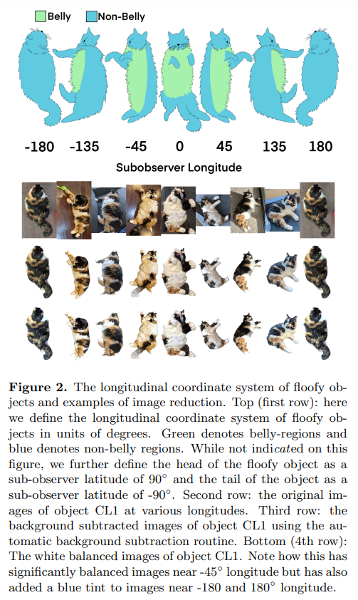
Data Analysis
Longitudinal coordinate system shown
Latitude coordinate system: head = 90°, tail = -90°
Row 1: raw images of object CL1
Row 2: background subtracted images
Row 3: white balanced images
Significant balanced images near -45°
Added blue tint to images near +/-180°
Notes:
Longitudinal coordinate system shown
Floofy object facing left = negative, right = positive
I don’t understand why the authors chose to use 45 and 135 instead of 60 and 120
Latitude coordinate system: head = 90°, tail = -90°
The authors are primarily interested in the belly to non-belly transition in these objects, the latitudinal dimension generally does not provide useful data
Further, floofy objects are less symmetric in this dimension and therefore studying any transitions is mostly beyond the scope of this work

Slide 8
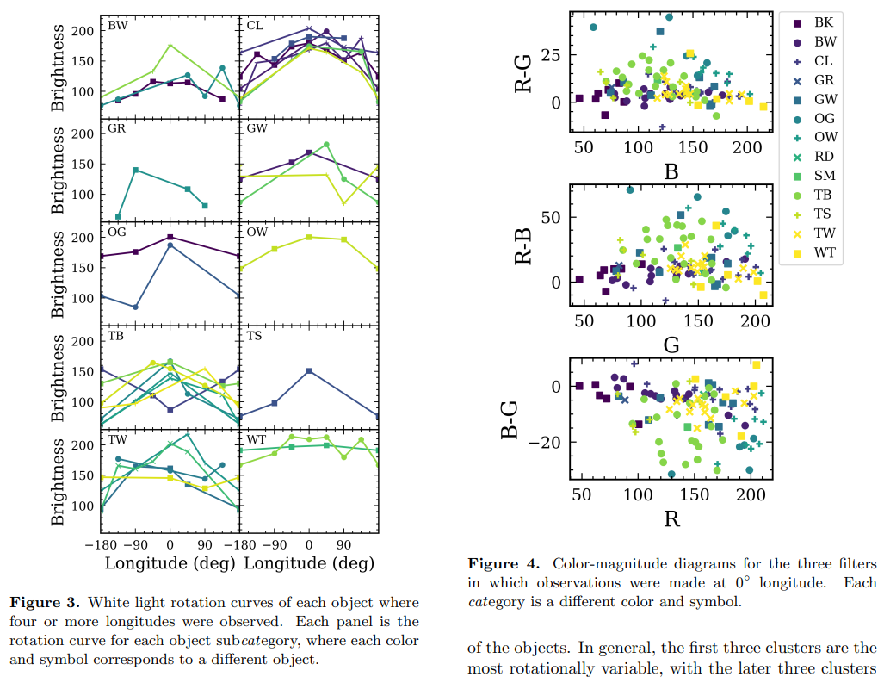
Results
Figure 3: white light rotation curves of objects with 4+ longitudes
Each panel = different sub-type
Each colored line = different object
Objects tend to be whiter and brighter at 0°
Exception: WT is roughly constant with longitude
Notes:
Figure 3: white light rotation curves of objects with 4+ longitudes
Each panel = different sub-type
Each colored line = different object
Interpretation: objects tend to be whiter and brighter at 0°
Exceptions
WT is relatively constant with longitude
Most sub-types suggest an increased brightness around 0° (TB and CL especially)

Slide 9
Results
Figure 4: color-magnitude diagram for all sub-type observations at 0°
BK and BW trend into TW and WT across 0° in all plots
The R−G vs. B plot is the most symmetric
TB and OG objects stray from 0° the most in all three plots

Slide 10
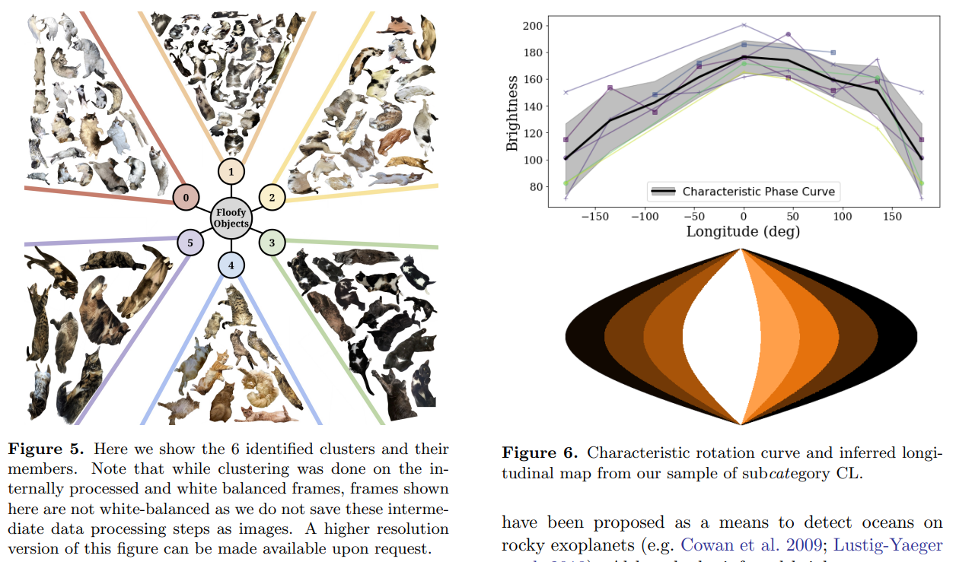
Results
Figure 5: cluster membership based on 0° images
Clusters 0, 1, and 2: predominantly bright at 0°, with differing colors visible on limbs
Cluster 0: many WT and CL objects with lighter limbs
Cluster 1: many BW objects with darker limbs
Cluster 2: limb colors lighter than cluster 1, but darker than cluster 0
Cluster 3: mostly BK sub-types, dark near 0° and on limbs
Clusters 4 and 5: mostly TB and OG sub-types, with cluster 4 being lighter and cluster 5 darker
Clusters 0, 1, and 2 are more rotationally variable
Clusters 3, 4, and 5 are more homogeneous

Slide 11
Shape and Rotation Rate
Resolved observations of floofy objects show that spatial inhomogeneities are the main cause of brightness variation
Can apply mapping utilities as developed for planetary objects
Determining size requires observing other objects for reference and comparison
A representative UFO can be created given a relatively large sample size
Notes:
Resolved observations of floofy objects show that spatial inhomogeneities are the main cause of brightness variation
floofy objects are more akin to planetary objects rather than small bodies, so we can apply mapping utilities as developed for planetary objects
Determining size requires observing other objects for reference and comparison

Slide 12
Results
Figure 6: rotation curve and longitudinal map for CL objects
Rotation curve: strong brightness peak near 0°, and drop near 180°
Longitudinal map: each colored slice indicates the mean brightness of CL objects at the given longitude
Notes:
Figure 6: rotation curve and longitudinal map for CL objects
Rotation curve: strong brightness peak near 0°, and drop near 180°
Longitudinal map
Projection of the rotation curve onto a 9-slice longitudinal map using the Python Basemap code
Each colored slice indicates the mean brightness of CL objects at the given longitude

Slide 13
Conclusions
The best observational targets are tidally locked, zero-obliquity Hot Jupiters
Light phase curve observations enable comparison with known light curves
Tidal locking and lack of rotational obliquity allow determination of the planet side at any given point in time
Further study of floofy objects is warranted as a function of temporal phase
Notes:
The best observational targets are tidally locked, zero-obliquity Hot Jupiters
Light phase curve observations enable comparison with known light curves
Tidal locking and lack of rotational obliquity allow determination of the planet side at any given point in time
Observations suggest that in addition to longitudinal differences of rotationally variable objects, further study of floofy objects is warranted as a function of temporal phase

Slide 14
Summary
328 floofy objects, 346 frames
13 different subcategories
32 different UFO rotation curves
Trends: UFOs are typically brighter and whiter at 0°
Cluster analysis determined that 0° observations were best represented by 6 subcategories

Slide 15
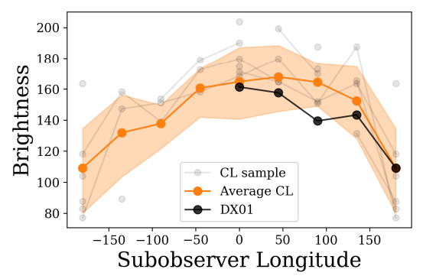
False Pawsitives
WOOF (Wagging tails On Objectively Friendly) objects: potential confusion with non-spatially resolved floofy objects
Figure 7: comparing the partial DX01 (WOOF Object) rotation curve to the average CL rotation curve
4/5 observations of DX01 fall within 1σ of the average CL sub-type rotation curve
The DX sub class is indistinguishable from the mean CL type object in unresolved observations
It is important to obtain resolved observations to differentiate between objects

