Slide 1
The Great Astronomy Debate of 1995: The Distance Scale to Gamma-Ray Bursts
Robert J. Nemiroff (Michigan Tech)
&
Jerry T. Bonnell (NASA/UMd)

Slide 2
Email: May 2, 1995
“It was a significant cultural moment, a day people seemed drawn to a scientific issue for its sheer intellectual interest more than from a personal attachment to the topic, a day that made one proud to be an astronomer.”
C. Megan Urry (Future President of the AAS)

Slide 3
Abstract
In 1995, on the precise 75th Anniversary of Astronomy's Great Debate on the Scale of the Universe between Shapley and Curtis and in exactly the same auditorium, a similar debate was held on the Distance Scale to Gamma-Ray Bursts. The 1995 debate was held in the same auditorium in Washington DC as the earlier Shapley-Curtis Debate. At the time of the 1995 debate, the GRB community was nearly equally divided between a galactic and cosmological distance scale. What was said, who attended, and how the great GRB distance scale controversy was eventually resolved is reviewed.

Slide 4
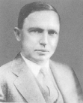
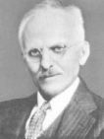
1920: The Scale of the Universe
Who: Shapley vs Curtis
When April 26, 1920
Where: Baird Auditorium, National History Museum, Washington, DC

Slide 5
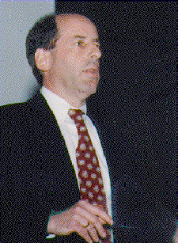
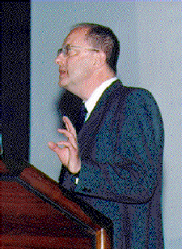
1995: The Distance Scale to Gamma Ray Bursts
Who: Lamb vs Paczynski
When April 26, 1995 (75th Anniversary)
Where: Baird Auditorium, National History Museum, Washington, DC

Slide 6
Has anyone here heard previously of the GRB “Great Debate”?

Slide 7
Email: September 9, 1994
Dear Virginia [Trimble],
I would like your opinion on an idea. As yet this is just an idea and no concrete steps have been taken. …
- Robert Nemiroff

Slide 8
Email: September 12, 1994
Bohdan [Paczynski],
Hi. I think you've already heard about this "debate" idea I was thinking of. Nevertheless, let me give you the song and dance. …
- Bob

Slide 9
Email: September 22, 1994
Bohdan,
I am sorry if I got you in trouble with some very prominent people. I had never told anyone that you would definitely participate …
- Bob

Slide 10
Email: September 22, 1994
Bohdan,
… I will pay you a $10K appearance fee to attend on 16 April. This money cannot come from any grant so I will put it up myself. …
- Bob

Slide 11
Email: September 23, 1994
Many thanks for the message. I'd be very happy to 'moderate' the debate as you suggest. Sunday 16th would be a free day for me.
Best wishes,
Martin [Rees]

Slide 12
Email: September 21, 1994
Dear Virginia,
An update and an invitation. What is still essential (in my view) is a brief background lecture on the actual Curtis - Shapley debate. You are far and away my first choice to give this lecture. (…)
- Robert

Slide 13
Email: November 22, 1994
Dear Judy Cash,
As we recently discussed on the phone, I am investigating the possibility of arranging for the use of Baird auditorium at the Natural History Museum for an event which would be sponsored in part by NASA. (…)
- Jerry Bonnell

Slide 14
Email: October 28, 1994
Dear Debate Program Participants,
The National Academy of Sciences in Washington DC has, at this point, "informally agreed" to house the debate. Someone at the meetings office pointed out to me that allowing us to us their main auditorium on both a weekend and on a day so close to their annual meeting is "almost unprecedented." Nevertheless, they want to charge money (more than $5K) but Vera Rubin has volunteered to ask them to defer most of it. (…)
- Robert

Slide 15
Email: April 26, 1995
Congratulations to all,
The PASP has agreed to publish the proceedings.
I will be away from this Friday until 15 May (marriage and honeymoon in Hawaii).
If there is any pressing business concerning the debate before then please contact Jerry Bonnell at bonnell@grossc.gsfc.nasa.gov.
- Bob

Slide 16
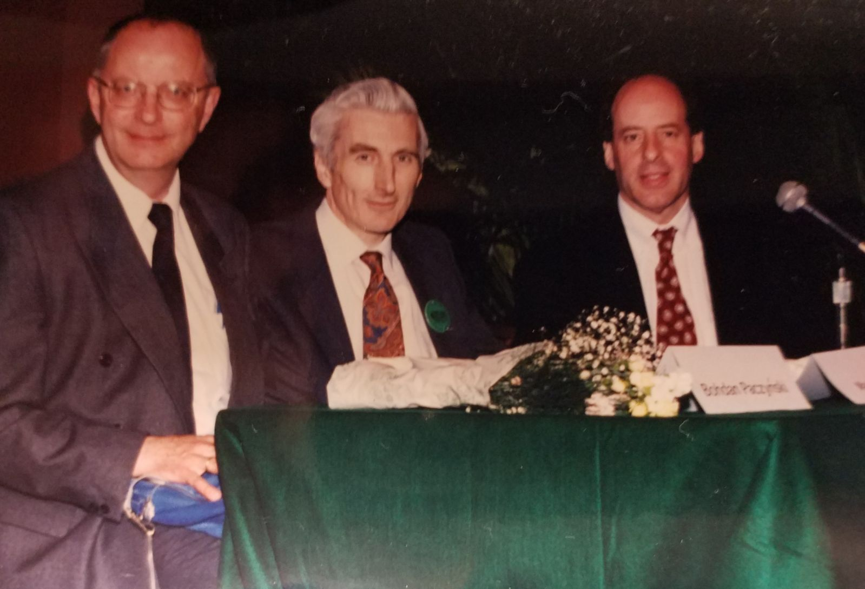
The Debaters

Slide 17
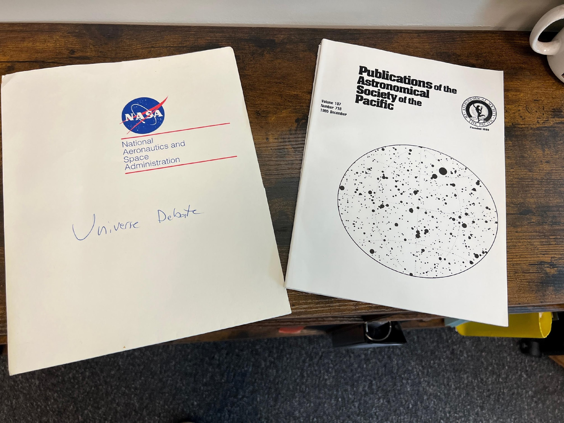
Literature and Swag

Slide 18
Telltale Dome

Slide 19
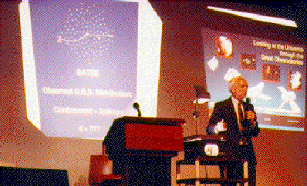
Setup Lectures: Trimble & Fishman

Slide 20
Almost time …

Slide 21
The Great GRB Debate

Slide 22
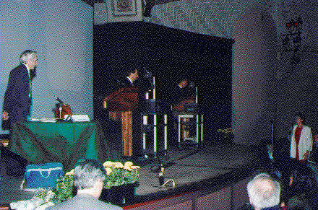
Questions from the Floor
Sterling Colgate
Chryssa Kouveliotou

Slide 23
Flowers for Everyone

Slide 24
“Great Debates in Astronomy” Web Pages
https://apod.nasa.gov/debate/debate.html
Google: “great debates astronomy”

Slide 25
Who is Robert Nemiroff?
Research
Gravitational Lensing
Gamma Ray Bursts
Sky Monitoring
Relativistic Illumination Fronts
Other Projects:
Astrophysics Source Code Library (ascl.net)
Astronomy Picture of the Day: apod.nasa.gov

Slide 26
What is APOD? Astronomy Picture of the Day
https://apod.nasa.gov/
Started at NASA in 1995
One of NASA’s most popular science websites
Currently: 1M+ pageviews per day
Typically: Every university accesses APOD every day
Translated by volunteers into ~20 languages
Available: web and most social media sites

Slide 27
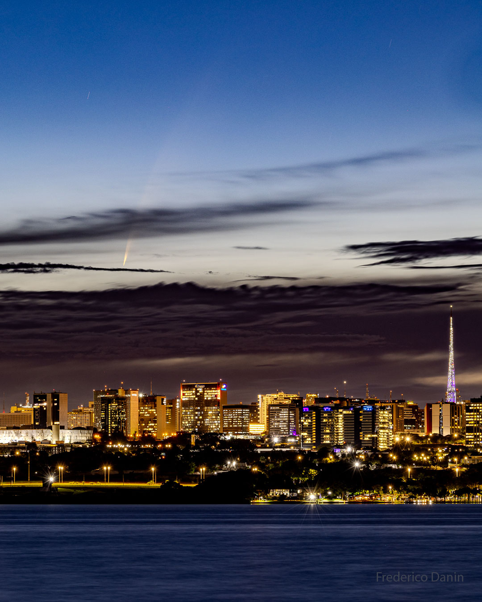
Today’s APOD
Comet ATLAS over Brasília

